Slide 1
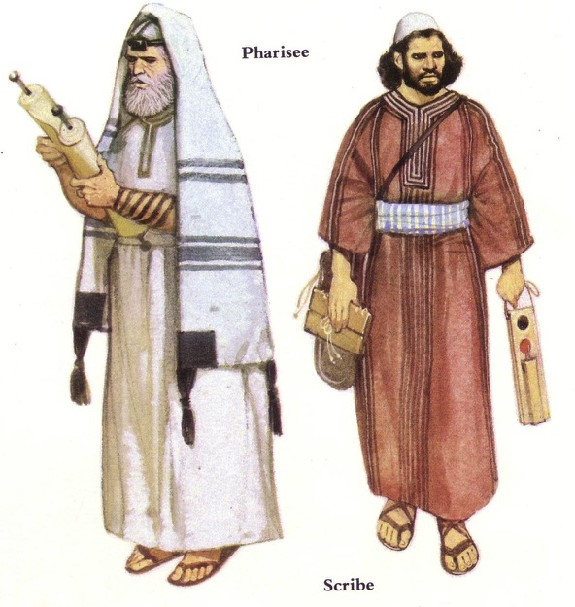
Jewish Sects
Influential Subgroups in First Century Israel
Dr. Rick Griffith • Jordan Evangelical Theological Seminary • BibleStudyDownloads.org

Slide 2
What is Spirituality?
115
Discuss these questions in your small group:
What makes a person godly?
Is it internal (being) or external (doing)?
How? Why?
Notes:
Choose one or the other: external or internal.
Why do you hold your view?

Slide 3
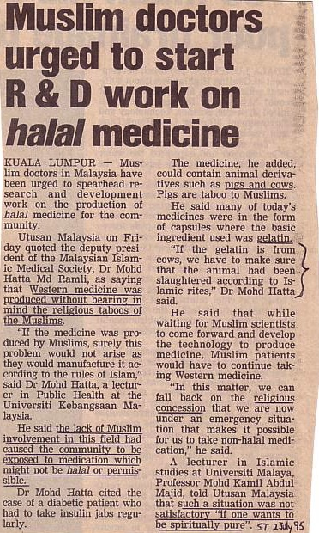
Other Religions Debate Spirituality Too
"Western medicine was produced without bearing in mind the religious taboos of the Muslims."
"The lack of Muslim involvement in this field had caused the community to be exposed to medication which might not be halal or permissible."
"If the gelatin [capsule] is from cows, we have to make sure that the animal had been slaughtered according to Islamic rites."
"Such as situation was not satisfactory
'if one want to be spiritually pure.'"

Slide 4
Religious Life in Israel
115
Very diverse due to 70-year exile
Many interpretations of the Law
Different synagogues

Slide 5
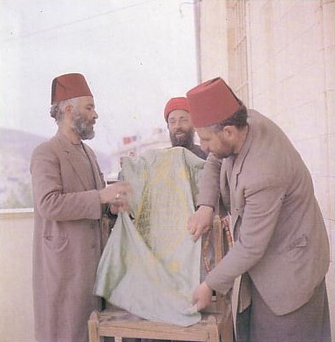
Samaritans stood outside of mainstream Judaism
115
Today 400 Samaritans live in Israel

Slide 6
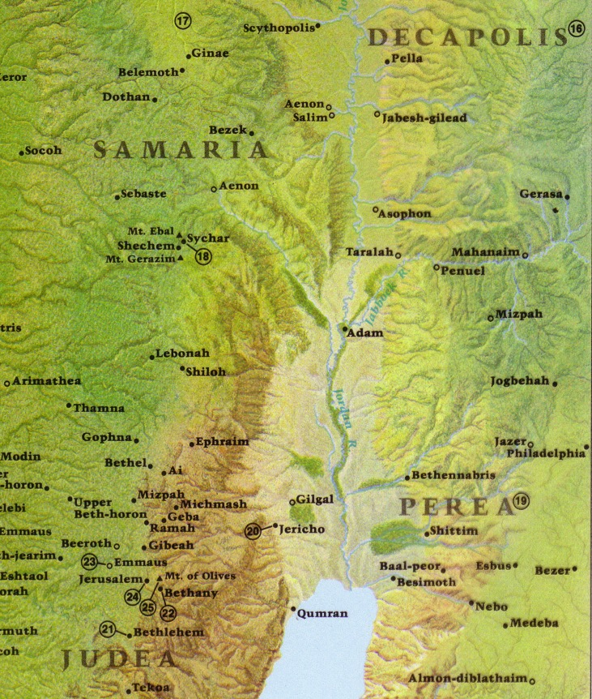
Reasons Jews hated Samaritans
107
115
See 2 Kings 17:24-33
• Mixed ancestry
• Idolatry
• Opposed Ezra's reforms
• Syncretism
• Temple on Mt. Gerizim
• Strewed human bones on Jerusalem temple
• Attacked Jewish travelers
Gerizim Temple
Jerusalem Temple
Coleman, Today's Handbook of Bible Times & Customs, 254

Slide 7
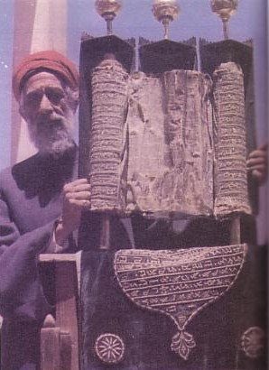
107
115
Reasons Jews hated Samaritans
See 2 Kings 17:24-33
• Mixed ancestry
• Idolatry
• Opposed Ezra's reforms
• Syncretism
• Temple on Mt. Gerizim
• Strewed human bones on Jerusalem temple
• Attacked Jewish travelers
• Held only the five books of Moses as Scripture
Coleman, Today's Handbook of Bible Times & Customs, 254

Slide 8
Prejudice Against Proselytes
115a
Pharisees made life difficult for proselytes (Matt. 23:15).
Proselytes were rejected because of their Gentile background.
Proselytes were suspect due to the means of their conversion.
Jews kept them from religious leadership.
Jews deemed them bastards because they assumed all Gentile women to be prostitutes.
Matthew 23:15 NIV “Woe to you, teachers of the law and Pharisees, you hypocrites! You travel over land and sea to win a single convert, and when he becomes one, you make him twice as much a son of hell as you are.”
Coleman, Today's Handbook of Bible Times & Customs, 254

Slide 9
The Jewish Sects
115
Small Groups: Identify the major trait of the sect assigned to your group and the closest contemporary church parallel
 | Key Traits | Modern Christian Parallels
a. Pharisees
b. Sadducees
c. Essenes
d. Zealots

Slide 10
The Pharisees
115
What were the Key Traits of the Pharisees?
Who are the Pharisees today?

Slide 11
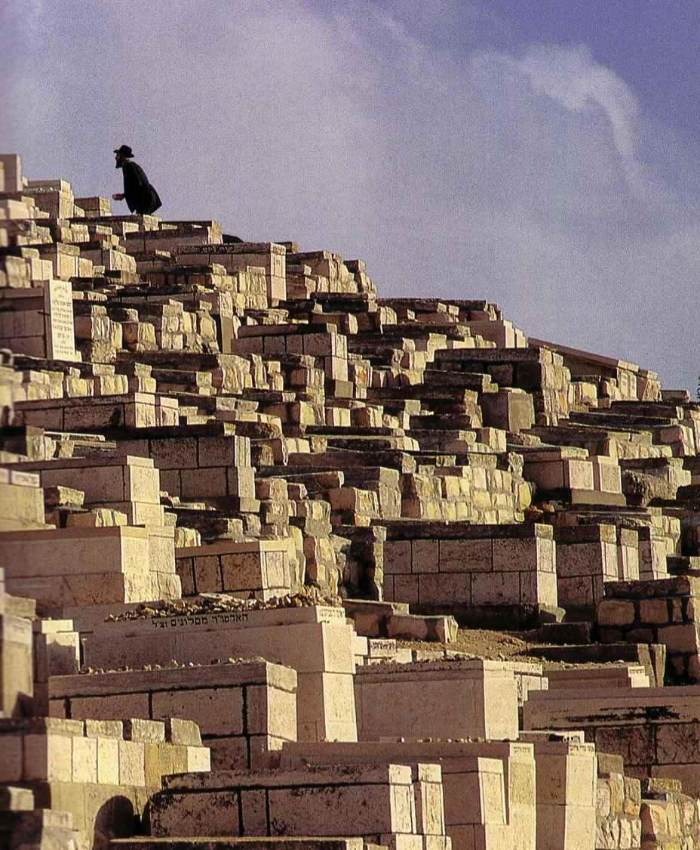
Be Close to the LORD
Jews buried here on the Mount of Olives hope to be the first to be resurrected and the first to join Messiah as He enters the Eastern Gate

Slide 12
The Jewish Sects
115a
Pharisees
Integration
Religion
Sicarii
Zealots
Politics
Sadducees
Herodians
Revolt
Resignation
Attitude towards life is in white
Isolation
Essenes
Samaritans
Notes:
Two sects lay at opposite ends of the political spectrum. Even beyond the Zealots were the Sicari (dagger men not considered a sect), and the Herodians, collaborators with the Romans also not generally thought a sect.
Likewise, two sects lay at polar extremes religiously with 6000 Pharisees involved in the life of the community while many Essenes withdrew to the Dead Sea.
Only about 1 in 20 Jews were involved in these sects, but they still wielded immense power just like a few religious and political leaders today have influence beyond than their elite few might seem.
_____
NB-10 Religion 1 Sects, Diaspora, Rabbis (115-26)-12
NS-00-NT Bkgrds-21

Slide 13
The Jewish Sects
115a
Pharisees
Integration
Religion
Sicarii
Zealots
Politics
Sadducees
Herodians
Revolt
Resignation
Attitude towards life is in white
Isolation
Essenes
Samaritans

Slide 14
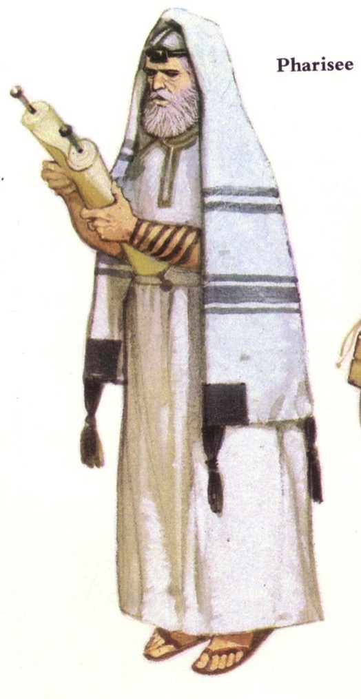

Pharisees
123
Roots: Hasidim (2nd cent. BC)
65-66
They accepted as equally inspired and authoritative all 39 OT books and the oral tradition.
They held to a mediating view that made it impossible for either free will or the sovereignty of God to cancel out the other.
They accepted a rather developed hierarchy of angels and demons.
Bible Visual Resource Book, 185

Slide 15
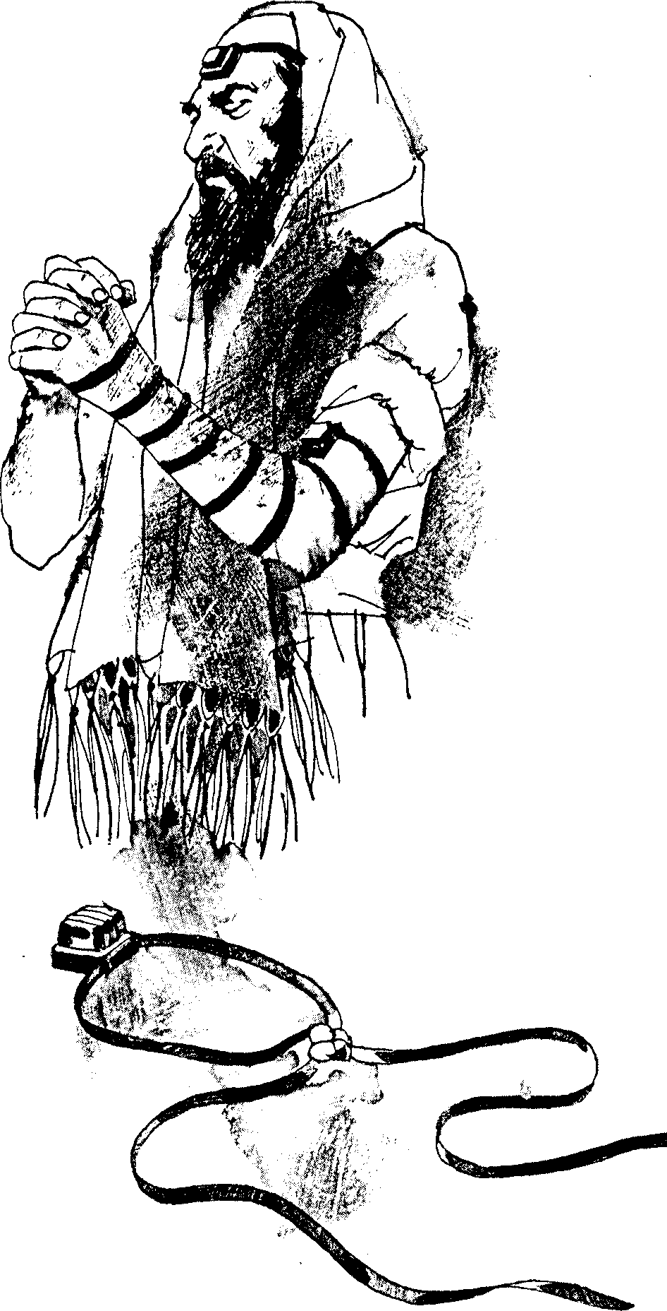
Pharisees
& Phylacteries
123
4. They taught that there was a future for the dead.
5. They believed in the immortality of the soul and in reward and retribution after death.
Bible Visual Resource Book, 185

Slide 16
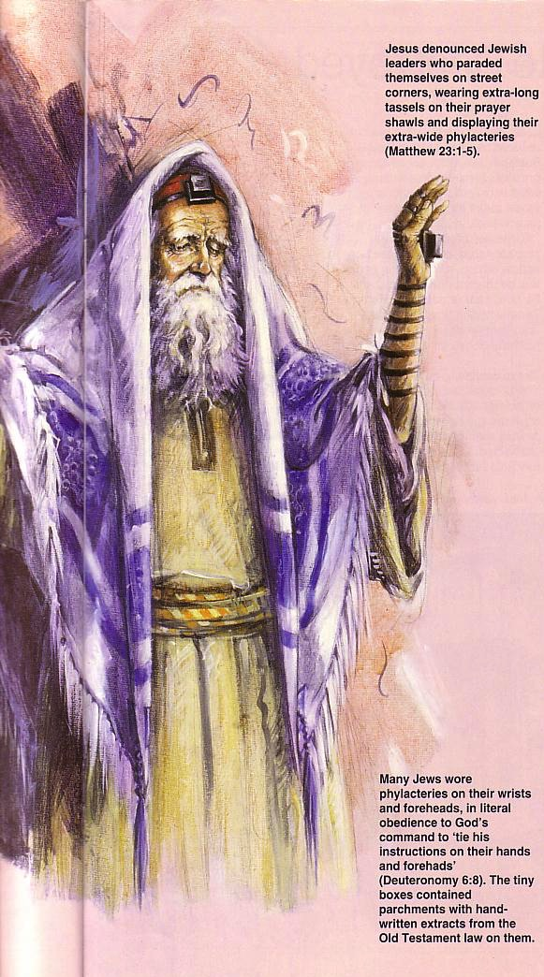
Pharisee Characteristics (cont'd)
123
123
6. They were champions of human equality.
7. The emphasis of their teaching was ethical rather than theological.
Jesus never questioned the theology of the Pharisees. Yet in Matthew 23 he exposed their hypocrisy in not practicing what they preached.
Bible Visual Resource Book, 185

Slide 17
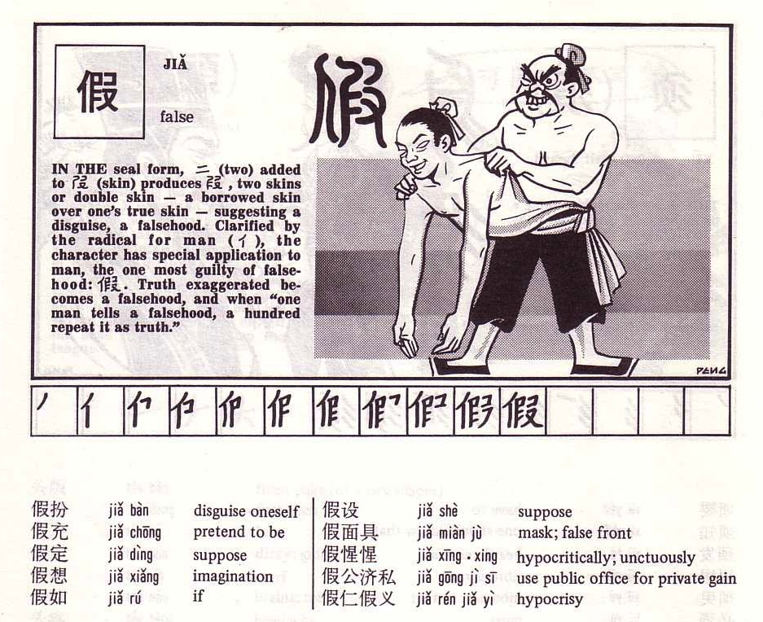
Chinese Pharisees?
124

Slide 18
The Sadducees
115
What were the Key Traits of the Sadducees?
Who are the Sadducees today?

Slide 19
The Jewish Sects
115a
Pharisees
Integration
Religion
Sicarii
Zealots
Politics
Sadducees
Herodians
Revolt
Resignation
Attitude towards life is in white
Isolation
Essenes
Samaritans

Slide 20
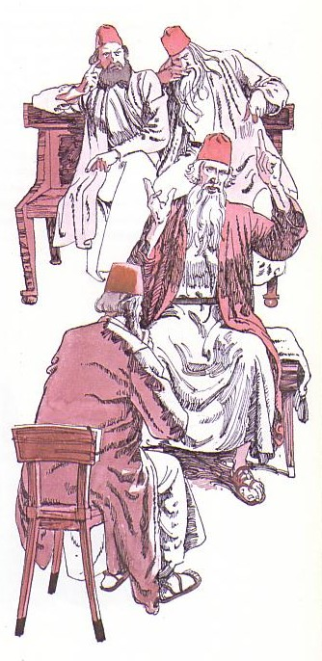
Sadducees
123
They probably began during the Hasmonean period (166 – 63 BC). They ended c. A.D. 70 with the fall of Jerusalem.
1.They denied that the oral law was authoritative and binding.
2. They interpreted Mosaic law more literally than did the Pharisees.
3. They were very exacting in Levitical purity.
4. They attributed all to free will.

Slide 21
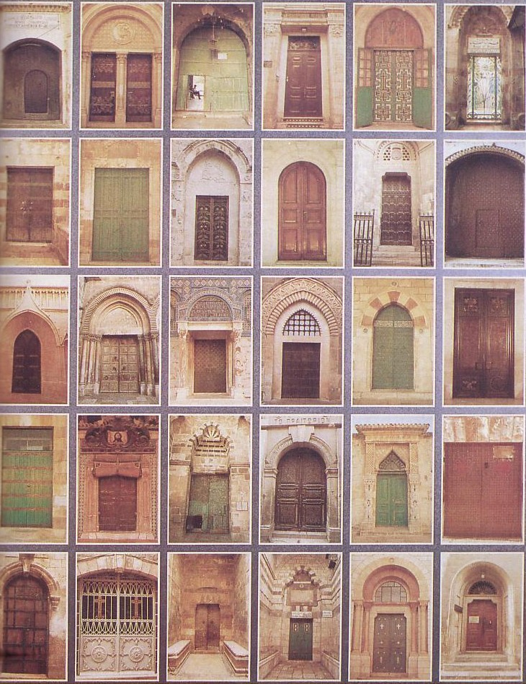
Sadducees went through any door into Jerusalem!
123
5. They argued there is neither resurrection of the dead nor a future life.
6. They rejected a belief in angels and demons.
7. They rejected the idea of a spiritual world.
8. Only the books of Moses were canonical.
Bible Visual Resource Book, 185

Slide 22
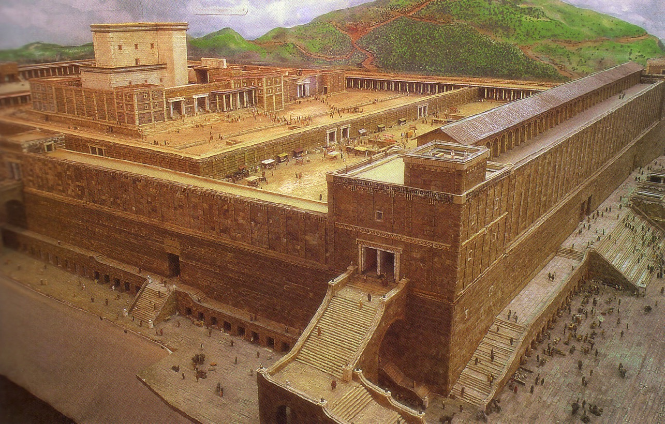
Southwest Corner of Temple Mount

Slide 23
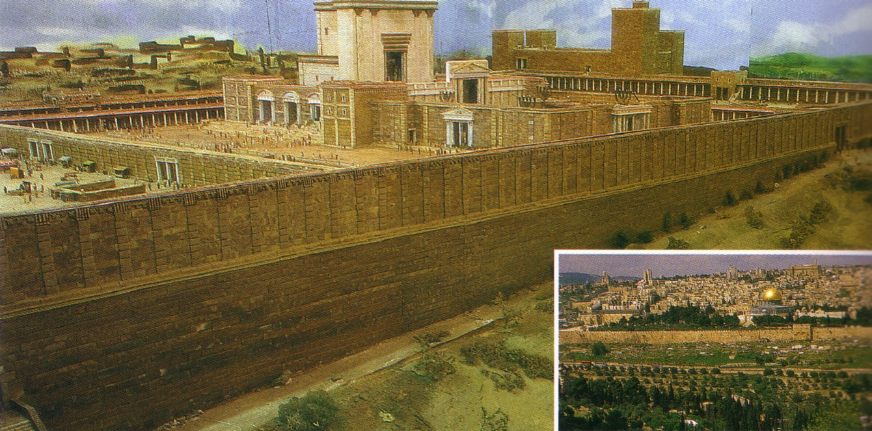
The East Wall of the Temple

Slide 24
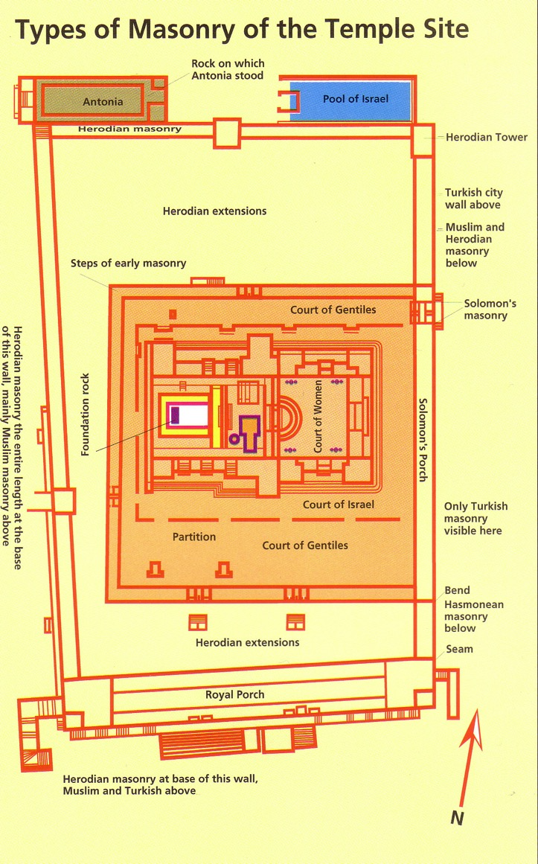
Types of Masonry of the Temple Site

Slide 25
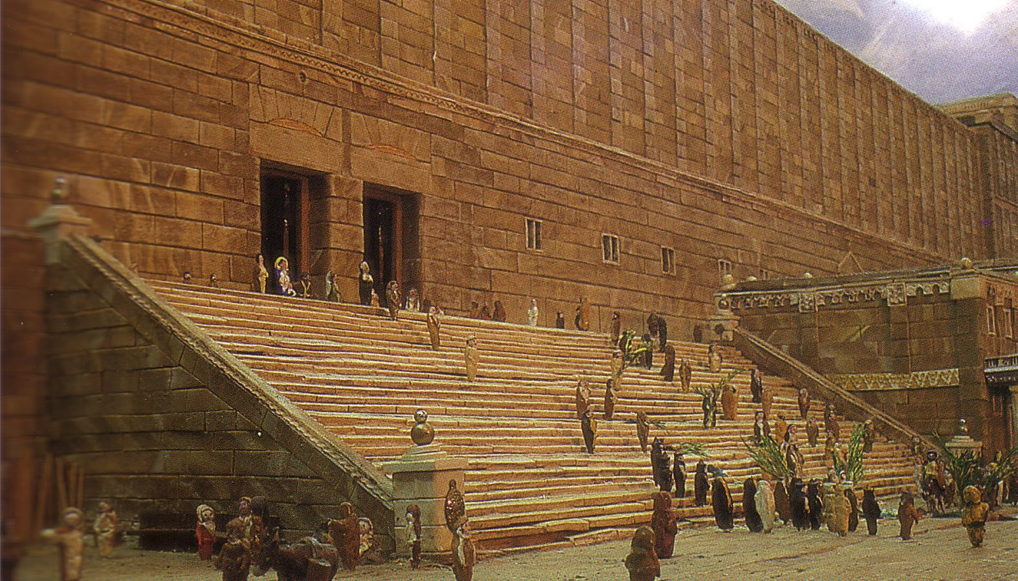
The Double Gate in the Southern Wall. People entered by the right hand gate and departed from the left.

Slide 26
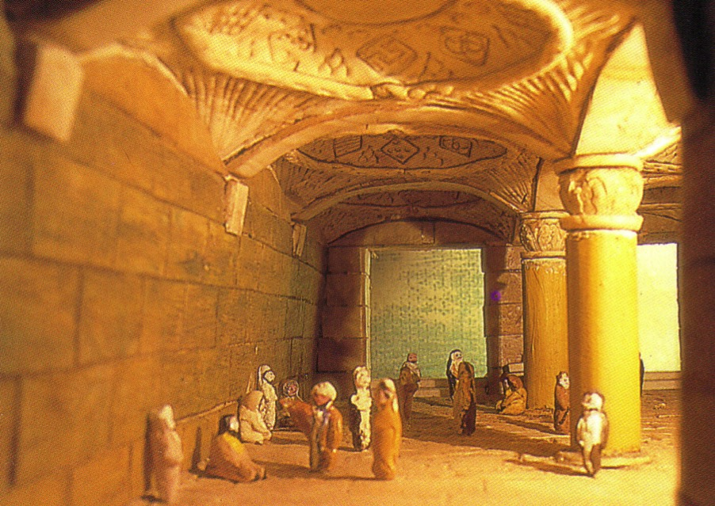
The domed passageway leading from the Double Gate into the outer courts.

Slide 27
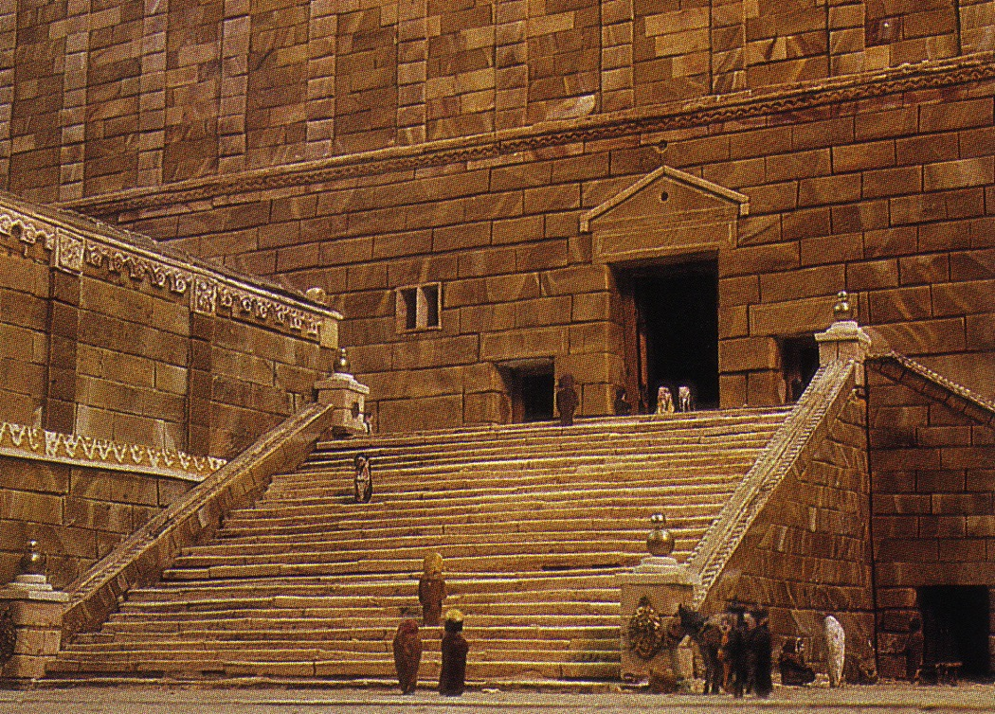
The Triple Gate, used by the priests of the temple.

Slide 28
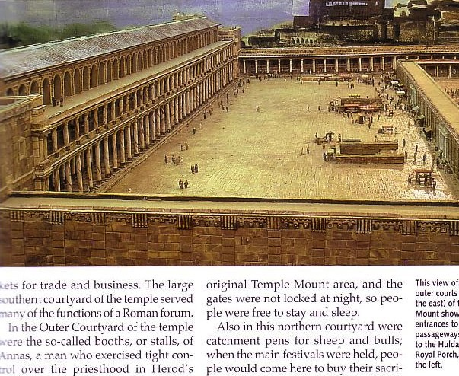
The Royal Porch (Stoa)
The Sanhedrin met in the Royal Portico at the south end of Temple Mount
The stairways led down to the Hulda Gates

Slide 29
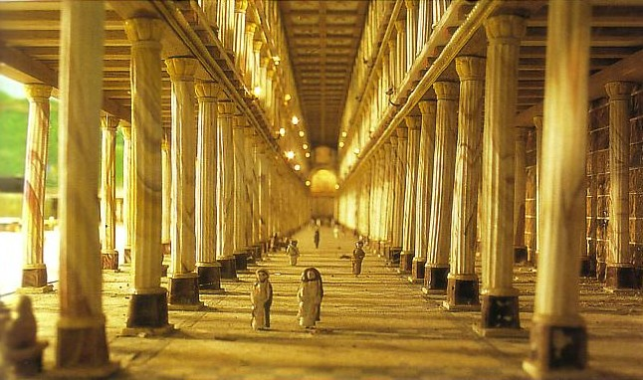
Interior of the Royal Portico

Slide 30
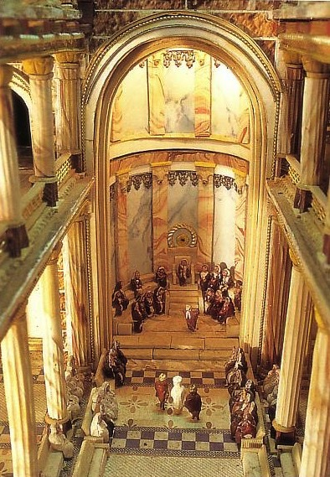
Meeting Place of the Sanhedrin
Semicircular hall at the east end of the Royal Portico
The 71-member Sanhedrin judged here from AD 30
Meetings public (except Christ's!) while Roman trials were closed

Slide 31

The Illegal Trial of Jesus
NTS 65
Closed meeting
At house of Caiaphas
Held at night
No specific charges
Accusations changed
No defense attorney
Violence
Condemned without proof

Slide 32
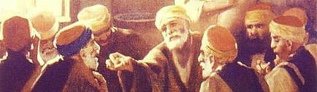
Who were the Jewish elders?
Lawyers?
Sadducees?
Pharisees?
Herodians?
Levites?
Scribes?
Chief Priests?
Essenes?
Zealots?
None of the above?

Slide 33
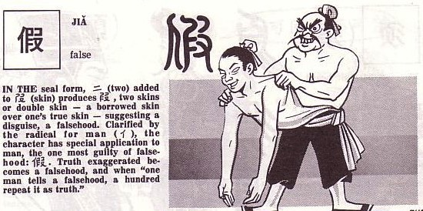
Both Pharisees & Sadducees Lacked Genuineness
124

Slide 34
The Essenes
115
What were the Key Traits of the Essenes?
Who are the Essenes today?

Slide 35

More Genuine Judaism Was Found in the Desert
THE DEAD SEA
JERICHO QUMRAN MASADA
Zealots
Essenes

Slide 36
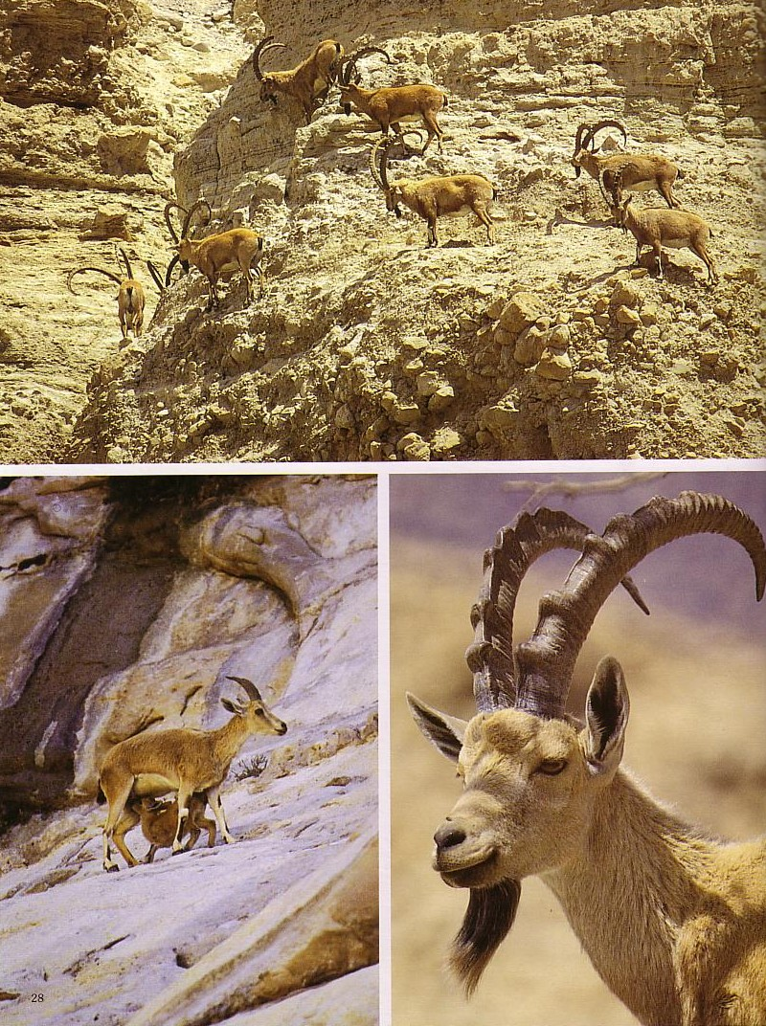
Until Essenes & Zealots opposed Jerusalem, mostly only animals lived in around the Dead Sea
Ibex
Gazelle
Ibex

Slide 37
The Jewish Sects
115a
Pharisees
Integration
Religion
Sicarii
Zealots
Politics
Sadducees
Herodians
Revolt
Resignation
Attitude towards life is in white
Isolation
Essenes
Samaritans

Slide 38
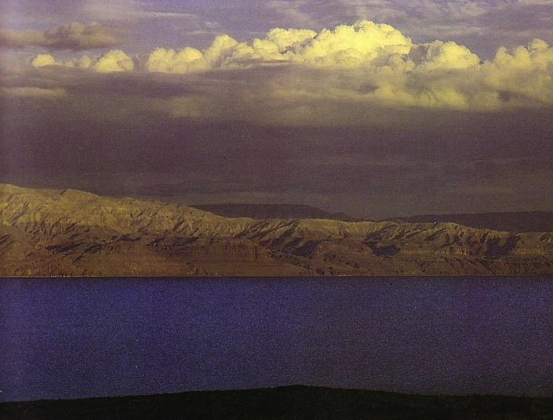
Essenes
123
They probably came from the Hasidim, along with the Pharisees, from whom they later separated (1 Macc. 2:42; 7:13). These strict and zealous Jews took part with the Maccabees in a revolt against the Syrians around 165-155 BC.
They strictly observed the purity laws of the Torah.
They were notable for their communal ownership of property.
They had a strong sense of mutual responsibility.
Daily worship was an important feature along with a daily study of their sacred scriptures.
Jewish Sects

Slide 39
Essenes
123
They probably came from the Hasidim, along with the Pharisees, from whom they later separated (1 Macc. 2:42; 7:13). These strict and zealous Jews took part with the Maccabees in a revolt against the Syrians around 165-155 BC.
They required solemn oaths of piety and obedience.
They sacrificed on holy days and in sacred seasons.
Marriage was not condemned in principle but was avoided.
They attributed all that happened to fate.
Jewish Sects

Slide 40
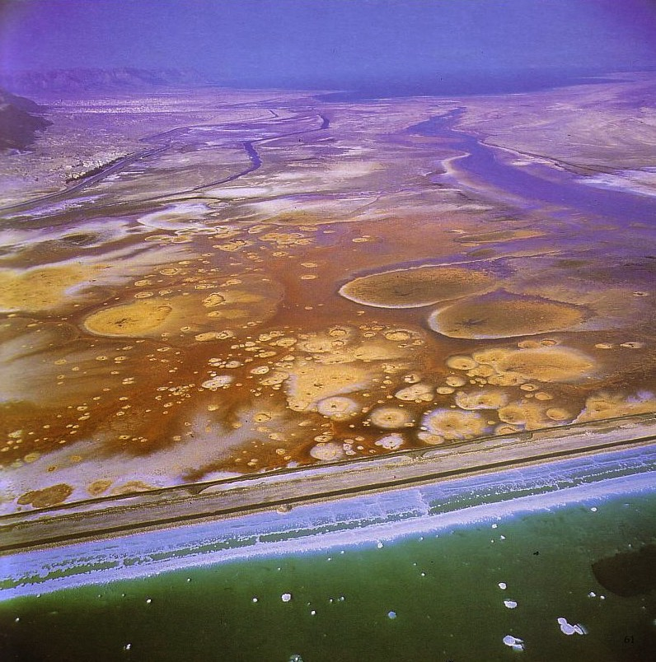
The Shrinking Dead Sea
“Moonscape” images appear from water depletion by both Israel and Jordan

Slide 41
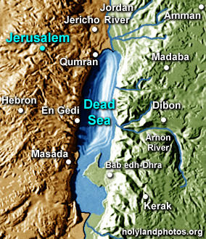
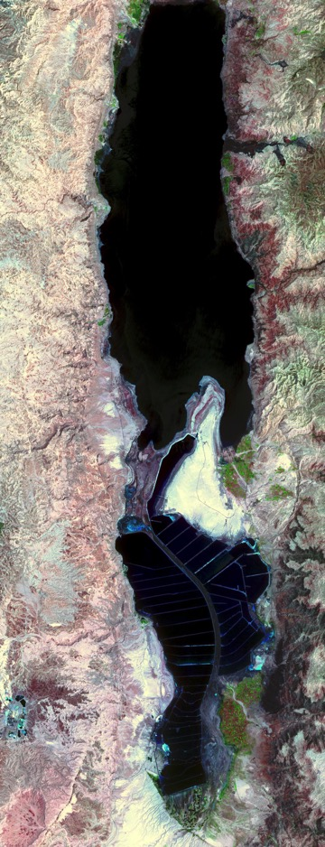
The Dead Sea–Then & Now
1st Century
22 May 2006
Notes:
NASA/GSFC/METI/ERSDAC/JAROS, and U.S./Japan ASTER Science Team at http://asterweb.jpl.nasa.gov/gallery-detail.asp?name=deadsea

Slide 42
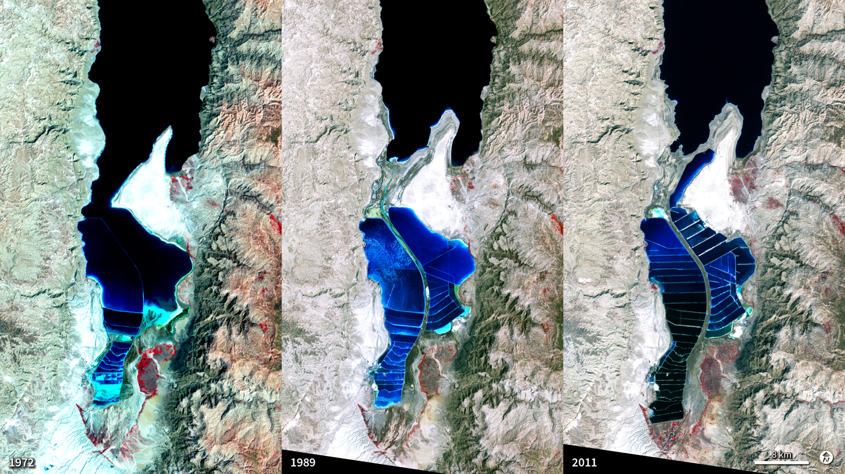
The Dead Sea–Then & Now
1972
1989
2011
http://svs.gsfc.nasa.gov/vis/a030000/a030000/a030053/
Notes:
“The Dead Sea is so named because its high salinity discourages the growth of fish, plants, and other wildlife. It is the lowest surface feature on Earth, sitting roughly 1,300 feet below sea level. On a hot, dry summer day, the water level can drop as much as one inch because of evaporation. These three false-color images were captured in 1972, 1989, and 2011 by Landsat satellites. Deep waters are blue or dark blue, while brighter blues indicate shallow waters or salt ponds. Green indicates sparsely vegetated lands. Denser vegetation appears bright red. The ancient Egyptians used salts from the Dead Sea for mummification, fertilizers, and potash (a potassium-based salt). In the modern age, sodium chloride and potassium salts culled from the sea are used for water conditioning, road de-icing, and the manufacturing of polyvinyl chloride (PVC) plastics. The expansions of massive salt evaporation projects are clearly visible over the span of 39 years.”

Slide 43
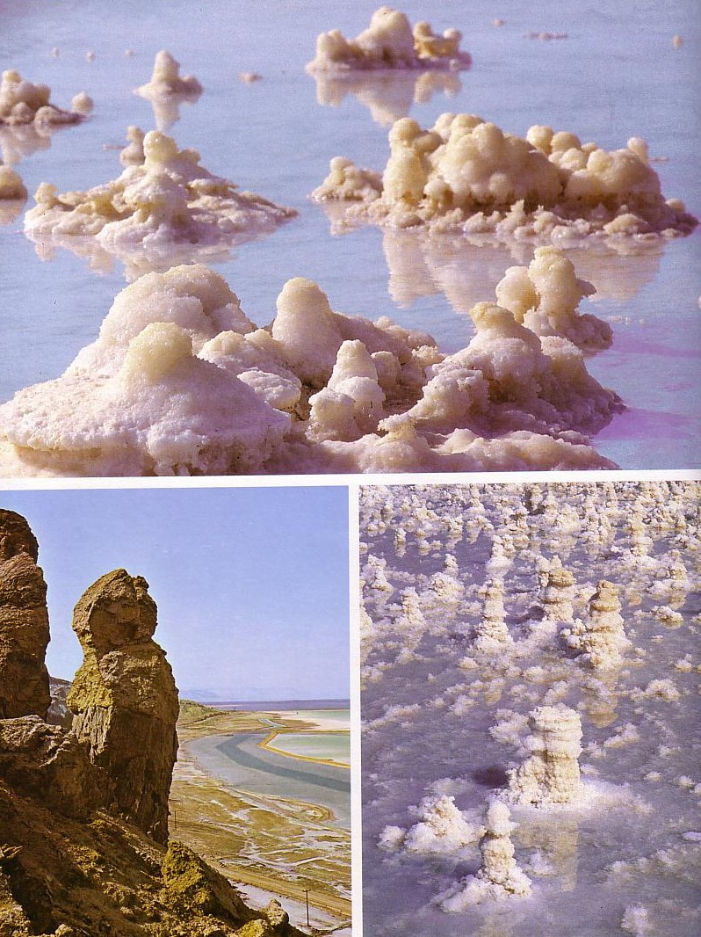

The Salt Sea

Slide 44
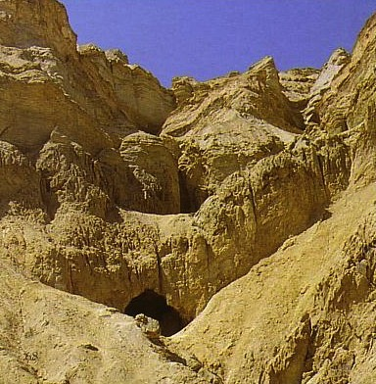
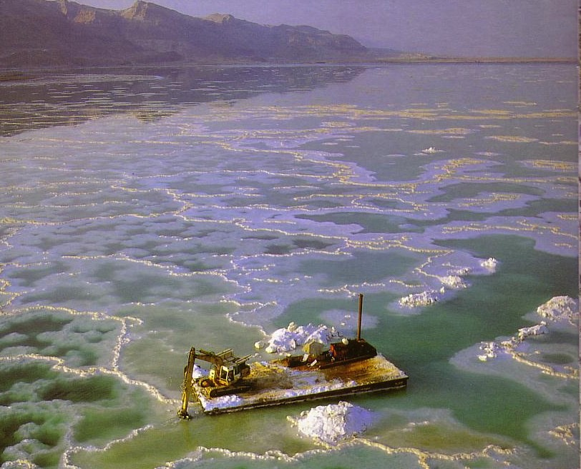
Mount Sodom

Slide 45
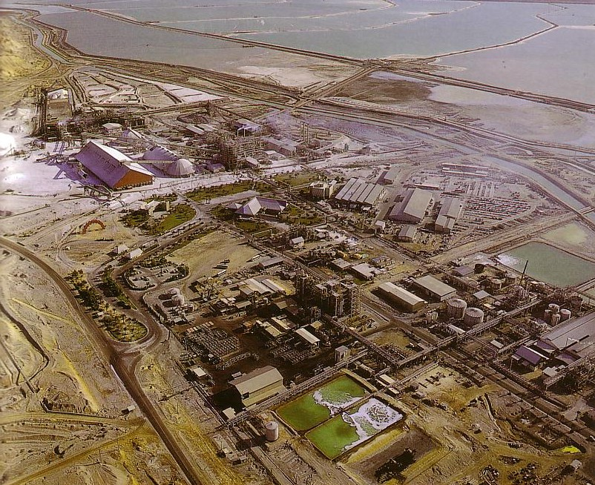
“Dead Sea Works”
Two miles south of Mount Sodom
Mining of potassium, chloride, magnesium, bromide, etc.

Slide 46
The Zealots
115
What were the Key Traits of the Zealots?
Who are the Zealots today?

Slide 47
The Jewish Sects
115a
Pharisees
Integration
Religion
Sicarii
Zealots
Politics
Sadducees
Herodians
Revolt
Resignation
Attitude towards life is in white
Isolation
Essenes
Samaritans

Slide 48
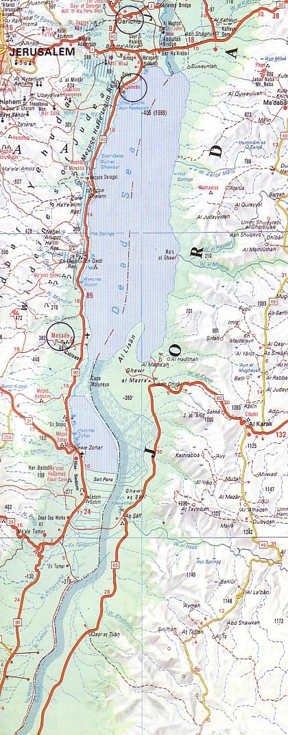
Zealots
123
Jerusalem
They originated in the time of Herod the Great ca. 6 BC.
They ceased to exist in AD 73 after leaving Jerusalem for their last stand at Masada.
Jewish Sects
Masada
Bible Visual Resource Book, 185

Slide 49
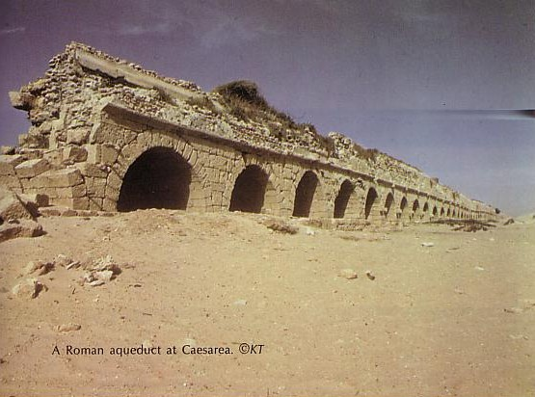
Zealots frowned upon Roman achievements
123
Jewish Sects
A Roman aqueduct at Caesarea

Slide 50
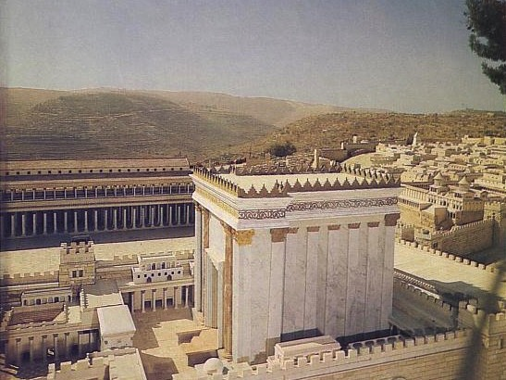
Zealots identified with the Temple

Slide 51
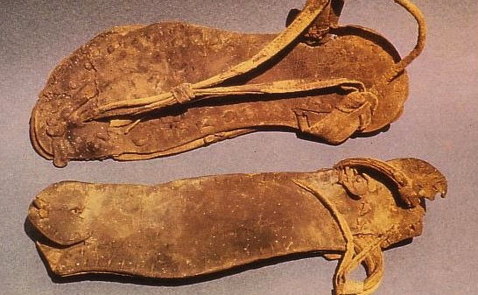
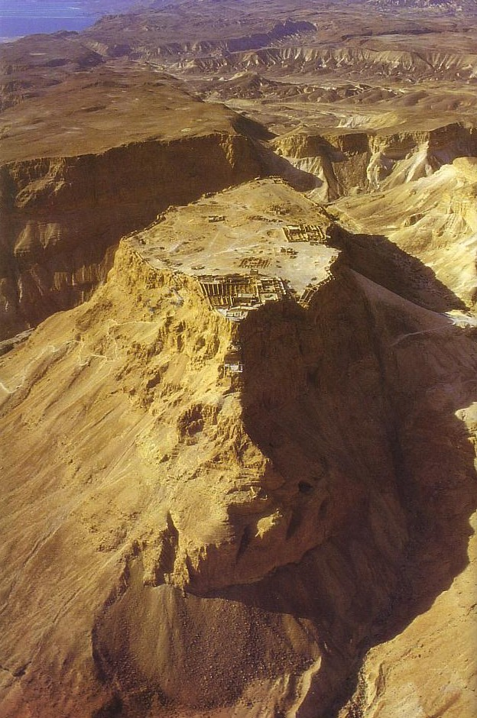
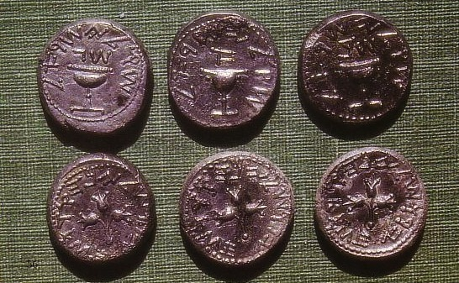
Zealots
123
Characteristics
1. They opposed taxes for the emperor, wanting allegiance to God alone.
Jewish Sects
Bible Visual Resource Book, 185

Slide 52
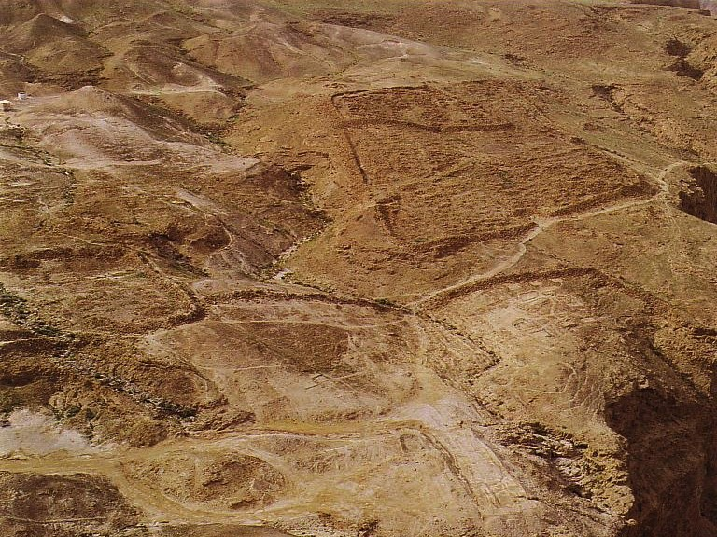
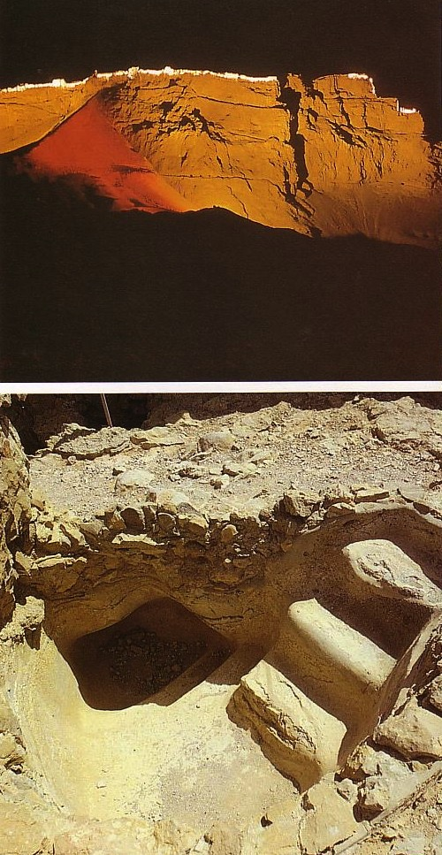
Zealot Loyalty
Characteristics (cont'd)
2. Zealots had fierce loyalty to the Jewish traditions.
Jewish Sects
The hated Roman camp at the base of Masada
A “Mikveh” ritual bath at Masada for Zealot immersion based on strict Jewish law
Bible Visual Resource Book, 185

Slide 53
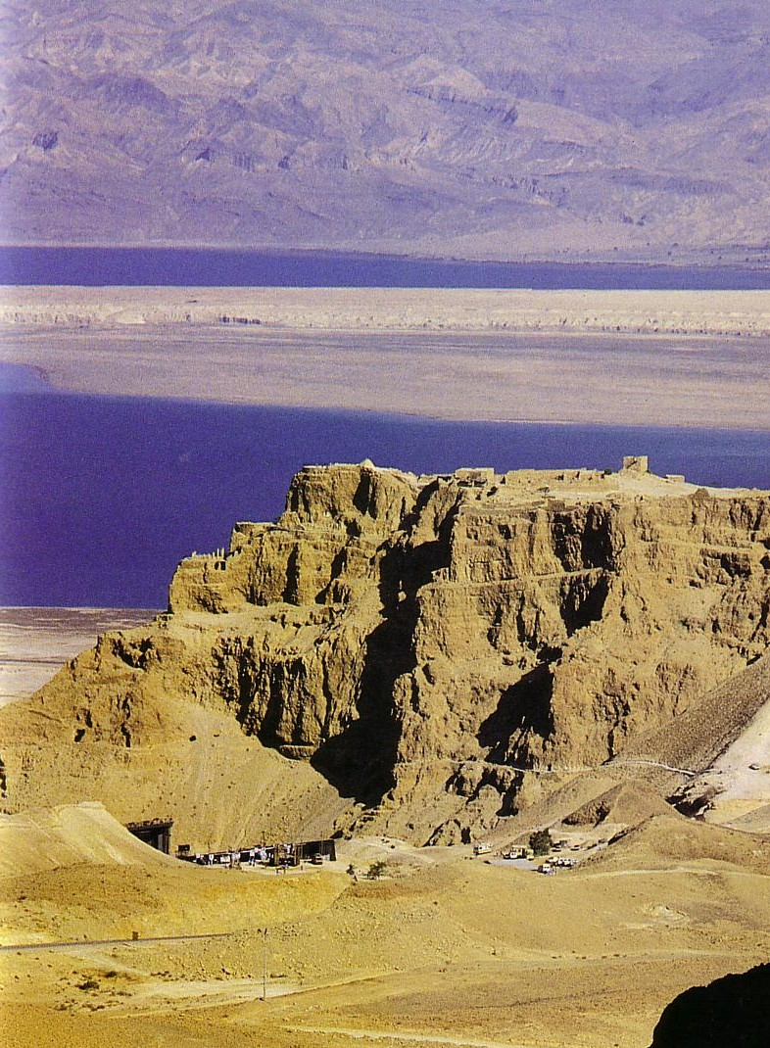
123
Characteristics (cont'd)
3. Zealots opposed using the Greek language in Israel.
4. Zealots prophesied the coming of the time of salvation.
Jewish Sects
Bible Visual Resource Book, 185

Slide 54
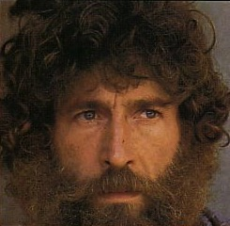
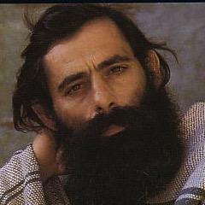
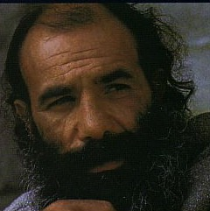
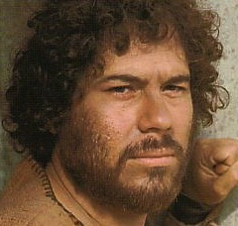
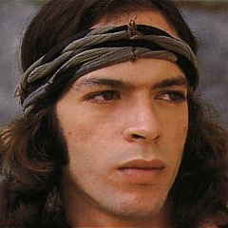
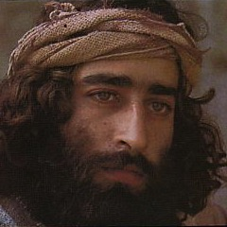
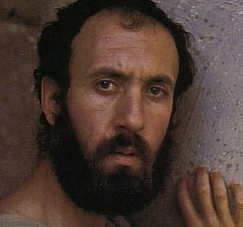
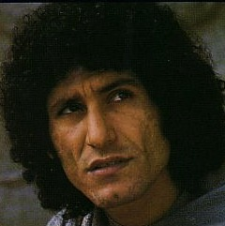




Twelve Who Followed Jesus
Peter
John
James
Bartholomew
Andrew
Thaddeus
James bar Alphaeus
Thomas
Philip
Judas
Matthew
Simon the Zealot

Slide 55

Masada Cisterns
Nine huge cisterns were carved into the Masada rock
These provided millions of liters of water for the Zealot defenders

Slide 56


Masada Cisterns
Stairs led to the bottom of each cistern

Slide 57

Herod's Northern Palace
This palace/fortress was seized by the Zealots
How? A Roman soldier dropped his helmet…
Notes:
Soldiers who did not have their full equipment were executed, so the soldier at the top who dropped his helmet climbed down to fetch it. Little did he know that Zealots hiding at the bottom of the plateau watched his every step and learned the secret path to the top. After dark, they climbed this same route and took the Romans by surprise, seizing the entire fortress that was used later for the Zealots to make their last stand.

Slide 58


Northern Masada Palaces
82
Bath Houses

Slide 59



How did ancients climb Masada?
The Snake Path

Slide 60


How do moderns climb Masada?
Tourists can easily climb Masada now on Swiss-built lifts

Slide 61


The Roman Offensive
Huge boulders pounded Masada's wall with catapults

Slide 62
The Jewish Sects
115a
Pharisees
Integration
Religion
Sicarii
Zealots
Politics
Sadducees
Herodians
Revolt
Resignation
Attitude towards life is in white
Isolation
Essenes
Samaritans

Slide 63




Sicarii vs. Herodians
125

Slide 64

The Jewish Diaspora
40,000 Jews in Rome alone!
125
83%
17%

Slide 65


Cornelius
A Gentile who admired Jewish ways (Acts 10)

Slide 66



Diaspora Judaism Alterations
125
The temple was replaced by the synagogue

Slide 67


Diaspora Judaism Alterations
125
Sacrifices were replaced by instruction & observing the Law

Slide 68


Diaspora Judaism Alterations
125
Religious rituals were replaced by ethical rules

Slide 69


Diaspora Judaism Alterations
125
The priest was replaced by the rabbi

Slide 70


Rabbinic • Discipleship • Jesus
126
Others sought them
Law
Quoted others
Impressed
Hebrew
Impersonal
Looked for others
Himself
Authority
Inspired
Aramaic
Personal

Slide 71


NT Backgrounds link at BibleStudyDownloads.org
Get this presentation for free!
Notes:
NT Backgrounds (nb)

Slide 72
Black

